Slide 1
WELCOME
GROUP B
Members
Surendra Pasi | Sabita yadav | Sandesh Paudel | Ashish Pasi

Slide 2


E-Governance: Revolutionizing Public Services
E-governance refers to the use of information and communication technologies (ICT) to improve the efficiency, transparency, and accountability of government services.

Slide 3

Defining E-Governance
E-governance involves using digital tools to deliver public services, interact with citizens, and manage government operations.
Digitalization
Transforming traditional government processes and services into digital formats.
Citizen Engagement
Providing platforms for citizens to participate in government decision-making and access services online.
Transparency & Accountability
Ensuring open access to information and making government operations more transparent and accountable.

Slide 4

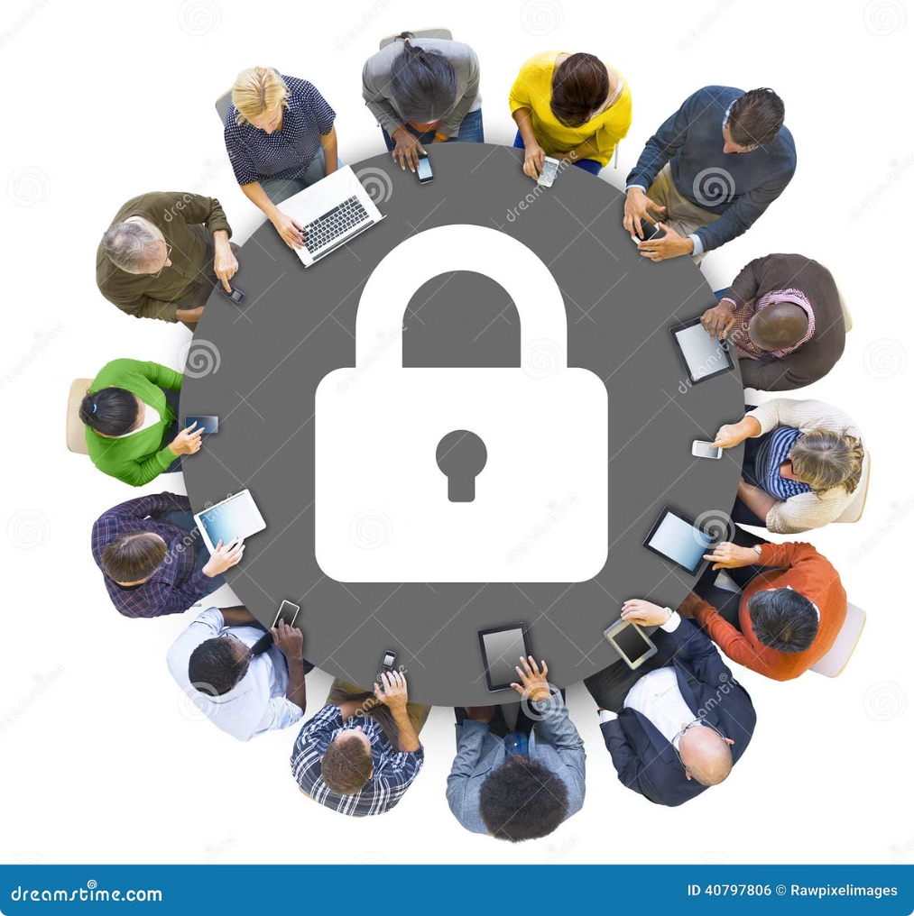
Applications of E-Governance
E-governance encompasses various applications that aim to simplify government services and improve citizen experience.
1
Online Tax Filing
Conveniently filing taxes online, reducing paperwork and wait times.
2
Digital ID Cards
Securely storing and accessing identity information electronically, simplifying identification processes.
3
Online Service Delivery
Providing access to various government services like birth certificates, passports, and licenses online.
4
E-Voting
Enabling citizens to cast their votes electronically, enhancing accessibility and security.

Slide 5
Types of E-Governance
E-governance can be categorized based on the actors involved and the purpose of the interaction.
G2C (Government to Citizen)
G2B (Government to Business)
G2G (Government to Government)
Focuses on delivering public services directly to citizens, such as online tax filing and registration.
Facilitates communication and transactions between the government and businesses, for example, online licensing and permits.
Involves collaboration and information sharing between different government agencies, such as data exchange and interagency coordination.

Slide 6
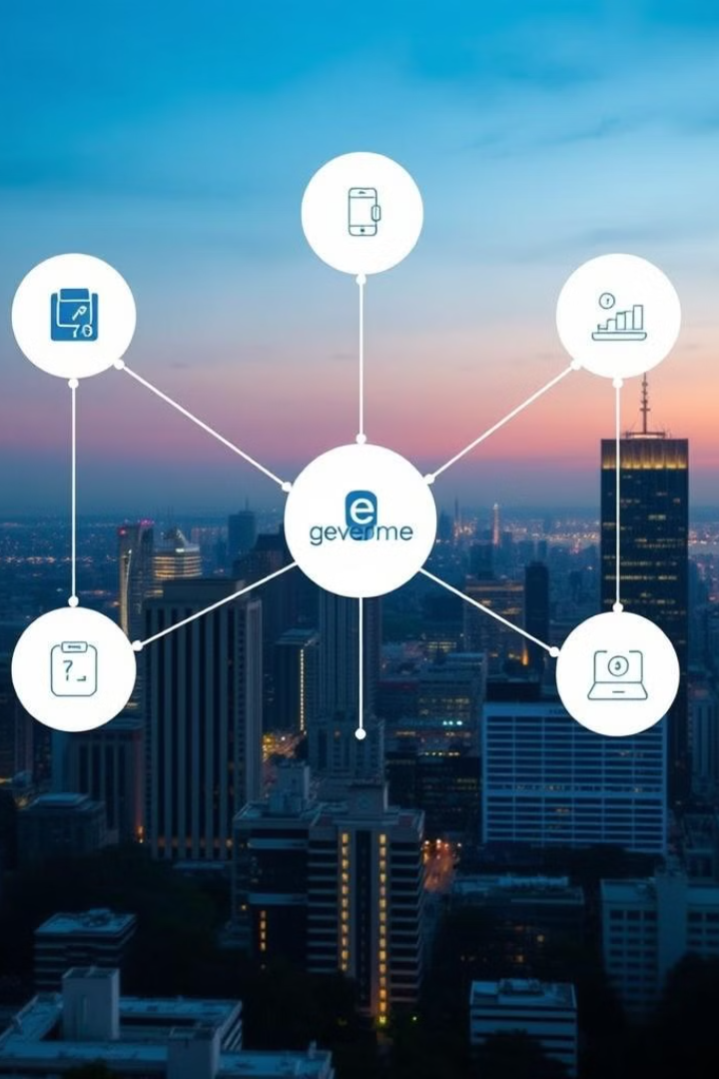




Components of E-Governance
E-governance systems require various components to function effectively and ensure seamless service delivery.
Information & Communication Technology (ICT)
Includes hardware, software, and networks necessary for digital service delivery and data management.
Legislation & Policy Framework
Provides legal and policy guidelines for implementing and regulating e-governance initiatives.
Human Resources & Capacity Building
Ensures that government personnel are equipped with the skills and knowledge to operate and maintain e-governance systems.
Citizen Engagement & Participation
Promotes citizen involvement in e-governance processes, ensuring user-friendliness and accessibility of services.

Slide 7


Advantages of E-Governance
E-governance offers several advantages, contributing to a more efficient and accountable government.
Transparency
Increased access to information and government processes, reducing corruption and fostering trust.
Efficiency
Streamlining processes and reducing paperwork, leading to faster service delivery and cost savings.
Accessibility
Providing services to citizens regardless of location, time, or physical limitations.
Accountability
Enabling tracking and monitoring of government performance, promoting accountability and transparency.

Slide 8





Disadvantages of E-Governance
While e-governance offers numerous advantages, it also presents certain challenges that need to be addressed.
Security Threats
Vulnerability to cyberattacks and data breaches, requiring robust security measures to protect sensitive information.
Privacy Concerns
Collecting and storing sensitive data raises concerns about privacy and potential misuse, requiring strong privacy regulations.
Digital Divide
Unequal access to technology and digital literacy can create disparities in accessing e-governance services.
Cost of Implementation
Developing and maintaining e-governance systems requires substantial investments in infrastructure and technology.

Slide 9
Scope of E-Governance in Nepal
Nepal has made significant progress in implementing e-governance initiatives, with various government services now available online.
Digital Identification System (DIS)
1
A national digital identity system providing a unique identification number for all citizens.
2
Online Tax Filing and Payment
Facilitating online tax filing and payment, simplifying the process for taxpayers.
E-Procurement System
3
Implementing an electronic procurement system to improve transparency and efficiency in government procurement.
4
E-Health Services
Expanding online health services, including telemedicine and digital health records.
E-Education Initiatives
5
Promoting online learning platforms and digital resources for students and educators.

